Slide 1

Systems Integration

Slide 2
The What and Why
System Integration
process of putting or bringing together the different systems into one system and ensuring that these interdependent systems function together as a unified system.
facilitates communication
Spaghetti Integration
Enterprise Integration
The strategic consideration of the process, methods, tools and technologies associated with achieving interoperability between IT applications both within and external to the enterprise to enable collaborative business processes.

Slide 3
Enterprise Integration
Is business driven rather than technology driven
Coordinates business processes with and cross different parts of the enterprise
Involves multiple stakeholders
Adopts a strategic rather than tactical or localized view

Slide 4
Business Problems
Information Aggregation
Presenting information from multiple IT sources into a single view
Single point of data entry
Replacing the need for manual and duplicate data entry into multiple IT applications
Process inefficiency
Reducing effort and time for business processes to complete
Web channel integration
Enabling web-based customers and other stakeholders access
Supplier integration and supply chain optimization:
Enabling a supplier to integrate with a larger company’s business process or an electronic marketplace

Slide 5
Discussion Point 1
Recall your internship/OJT?
Can you identify/mention business problems that perhaps exist because of having several disconnected systems?

Slide 6
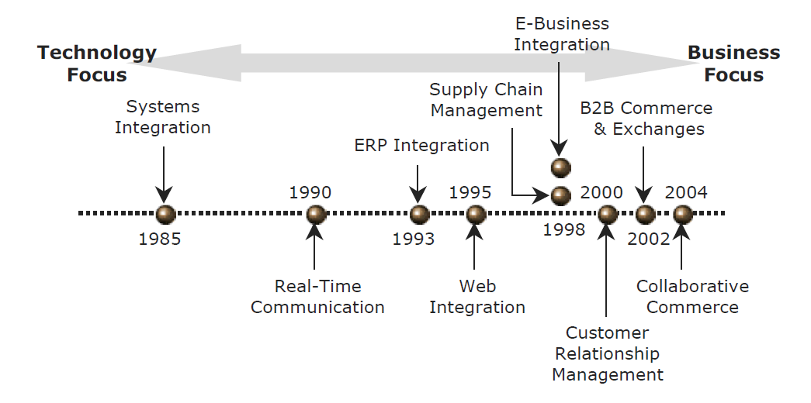
Sourse: Enterprise Architecture and Integration: Methods, Implementations and Technologies by Wing Lam

Slide 7
Systems Integration Methods
Horizontal Integration
Creation of a subsystem meant to be the interface between all other subsystems
Also referred to as Enterprise Service Bus (ESB)
Vertical Integration
Creation of depositories or silos
Star Integration
Sub-systems are connected with other sub-systems using point-to-point connections
Common data format/integration
set a common or application-independent format, or they provide a service that does the transformation to or from one application into the common application.

Slide 8
Discussion point 2
Consider again the organization you work at during your OJT. Based on the different methods of integration, which one(s) can be used? Or if there are integrated systems already in place, what method(s) do you think are implemented?

Slide 9
Integration Types
Enterprise Application Integration – EAI
Data Integration (DI)
Electronic Data Interchange – EDI Integration

Slide 10
Discussion Point 3
Define and give software examples that can be used for these types of integration: EAI, DI, and EDI
(one example for each)

Slide 11
Discussion point 4
Can you guess what steps can be taken for systems integration?

Slide 12
General Steps in Systems Integration
Requirements Gathering
Data Analysis
Design Architecture
Design Systems integration
System Implementation

Slide 13
Discussion point 5
Can you phrase questions that will assess the need for integration?

Slide 14
Assessing the need for Integration
Is there a requirement to collate information from several IT systems in real time to meet specific business objectives?
Does the organisation have many IT systems that need to communicate with each other?
Is there a need to key in and update the same details in separate IT systems?
Is it difficult and time consuming to extract information from several IT systems?
Does the organisation batch upload information from one IT system to another?
Is the same information duplicated across many IT systems?
Is there an issue with data inconsistency between IT systems?

